Slide 1


Azure Workshop
Resource Management
NOVEMBER 17, 2018

Slide 2

Agenda
Resource Model
Resource scaling
Azure troubleshooting
Resource monitoring
Resource logging
Remote debugging
Demo
Q&A

Slide 3
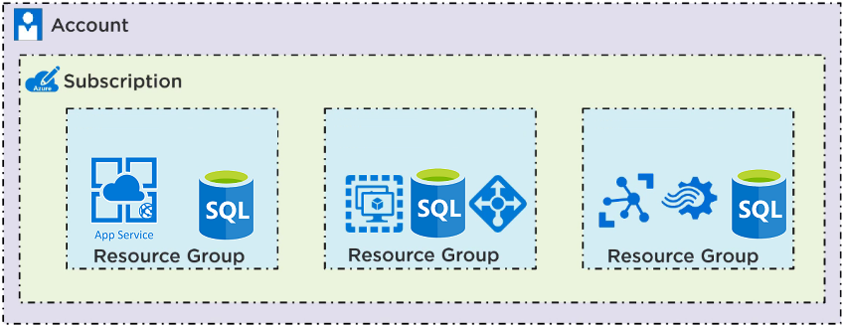
Resource Model
Resource – An item that is part of your Azure solution.
Resource group – A container in Resource Manager that holds related resources for an application. You can compare it to the directory on your computer. It useful for controlling the group of the resources that compose your solution.

Slide 4
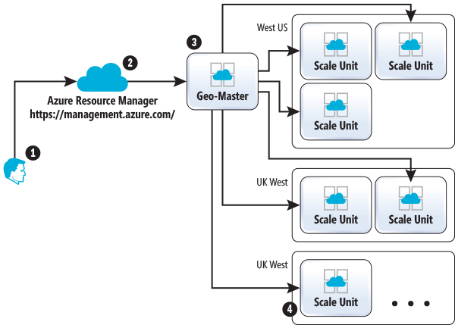
Resource Scaling
What resources could be scaled:
App services (Some of them – under the hood)
Relational databases
Cosmos DB (under the hood)
Virtual machines
How is it done?
Inside the Azure App Service Architecture

Slide 5
Scaling Demo

Slide 6
Azure troubleshooting

Slide 7



Resource Monitoring
Tools for monitoring Resources:
Microsoft Azure Monitor
Application Insights
Log Analytics
Notes:
Azure monitor
Core monitoring component
Metrics, activity logs, diagnostic logs
Could be opened in a separate blade on the Azure portal
Different level of monitoring depending on the Service plan
Shows subscription information (how much money is left)
Alerts - you can setup the system of alerts (if something goes wrong you'll get notified)
Metrics -
Activity log - log events, any incidents like network availability, history of the resources.

Slide 8
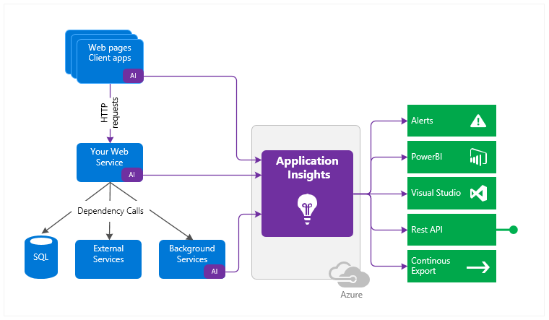
Application Insights
Data is collected at every tier and sent in cloud for processing
Provides Monitor with data
Provides you with the tools for an analysis
Integrated in VS and Azure DevOps
Notes:
Application performance management service for web applications
Allows you to monitor performance and performance anomalies and helps you to diagnose issues.
Gives you an information about how users use your web application.
.Net Js J2EE
Sending data to the Azure, but the Web App shouldn't be hosted in the Azure.
Could be used for insuring the incremential growth of the performance
How it works:
> You insert a small package into your application.
> And setup the Application Insights resource in Azure
> Web App is monitored and sends telemetry to the Azure
> You could add Your host logs(server logs, container logs, system logs)
You can setup the performance test. From time to time Azure will ping your web application to check if it is working properly or not
Points of interest:
Most viewed pages. At what time of the day and from where the trafic comes. A lot of other platforms can provide you with this details, but AI also does the analitics. It shows the responce times(both inside application and out of application), failure rates, etc. It'll help to find which External server causes the issue. Shows exceptions trace logs, session data(who when, what).
Could be customized.
Always nice what is the most popular resource, to analize processes.

Slide 9
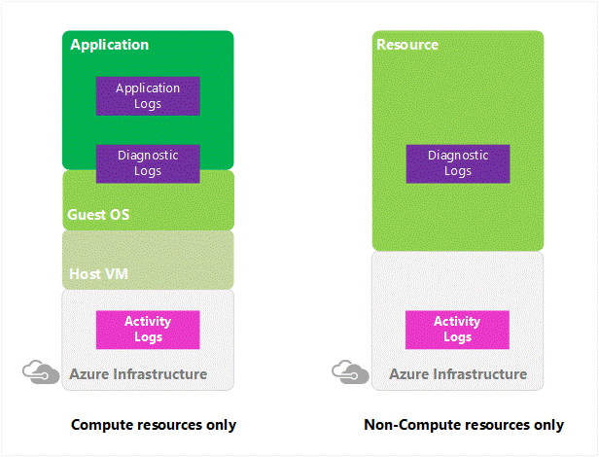
Resource Logging
Logging levels:
Control/management logs
Data plane logs
Processed events
Azure logging and auditing
Notes:
Control/management logs provide information about Azure Resource Manager CREATE, UPDATE, and DELETE operations.
Data plane logs provide information about events raised as part Azure resource usage. Examples of this type of log are the Windows event system, security, and application logs in a virtual machine (VM) and the diagnostics logs that are configured through Azure Monitor.
Processed events provide information about analyzed events/alerts that have been processed on your behalf. Examples of this type are Azure Security Center alerts where Azure Security Center has processed and analyzed your subscription and provides concise security alerts.

Slide 10
Remote debug
Notes:
DON’T DO ON PRODUCTION (Hitting break point doesn’t allow to respond to other requests)
Enable just my code set to false
Should set App Settings to allow debugger
Publish with debug configuration
Attach to process via server explorer

Slide 11
Azure portal demo

Slide 12

References
Azure glossary
Great explanation of what is Application Insights from the Microsoft senior architector
Inside the Azure App Service Architecture
Azure logging and auditing

Slide 13
Q&A
Credentials:
Dmitrii Gvozdev
Email: Dmitrii_Gvozdev@epam.com
Telegram: @GvozdevDA

